Slide 1
Electronics
Week 3a

Slide 2
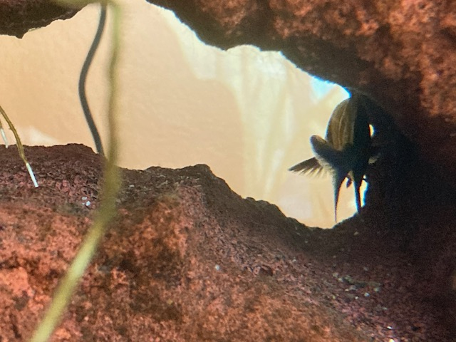
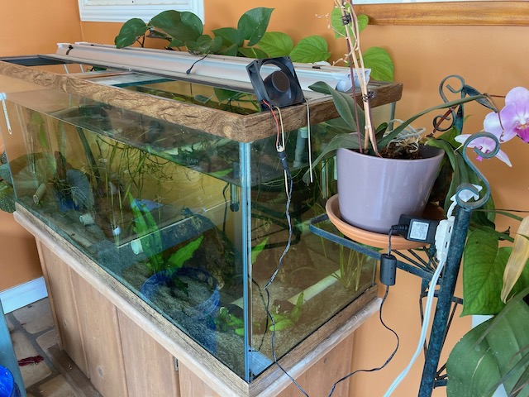
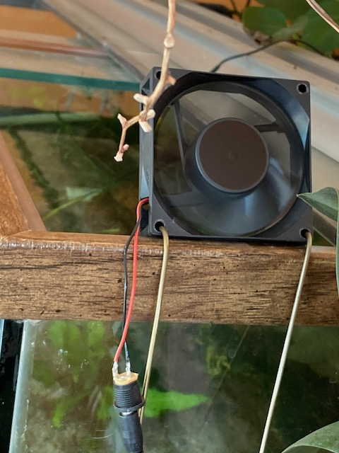
Soldering saved my fish …
My fish tank was 86 degrees at 7am …
It takes a lot of ice cubes to cool 70 gallons of hot water
What to do?
Evaporative cooling …

Slide 3
Today’s goals
Questions?
Homework
Read and work problems in Chapter 2 this week
Review the LED nightlight lab report
Install on your computer the Arduino IDE (www.arduino.cc), Matlab, and optionally installing free version of Eagle CAD or Kicad
Some theory about resistors, capacitors, & solder
Design, prototype and build a variable DC power supply
This will become key apparatus for subsequent explorations

Slide 4
What are Resistors?
Resistance is in many ways analogous to friction
Electrons collide with atoms or grain boundaries, imperfections in the lattice, … and lose kinetic energy
Sound like a good fairytale?
Our small ¼W resistors are made with a metal film over an insulating substrate, who’s composition and geometry define the resistance
Bulk materials with resistivity ρ can be molded into resistors with resistance R = ρL/A, where L is the length and A is the cross-sectional area. ρ has units of Ω-cm.
L
L

Slide 5
What are Capacitors?
2nd most common (ubiquitous) passive electronic component
Made of two conductors separated by an insulator
Charge moving onto one conductor will repel or displace charge on the other conductor
For DC circuits (with constant voltages), capacitors behave as open circuits
Time-varying currents flow through capacitors …
Some capacitors are polarized – respect that!
They can store a lot of energy (i.e., lethal amounts) – and (ideally) give that energy back to the circuit
E.g., the long glow after the LED nightlight was unplugged
They can act like mass in mechanical dynamic systems, giving circuits inertia that impedes voltage changes
There are many useful ways to think about and model their functions, that we’ll be exploring later on (e.g., with complex numbers, ... )
Notes:
What does “passive” mean? We’re inventing some language here … recycling existing words with new meaning, and a few times creating new ones.

Slide 6
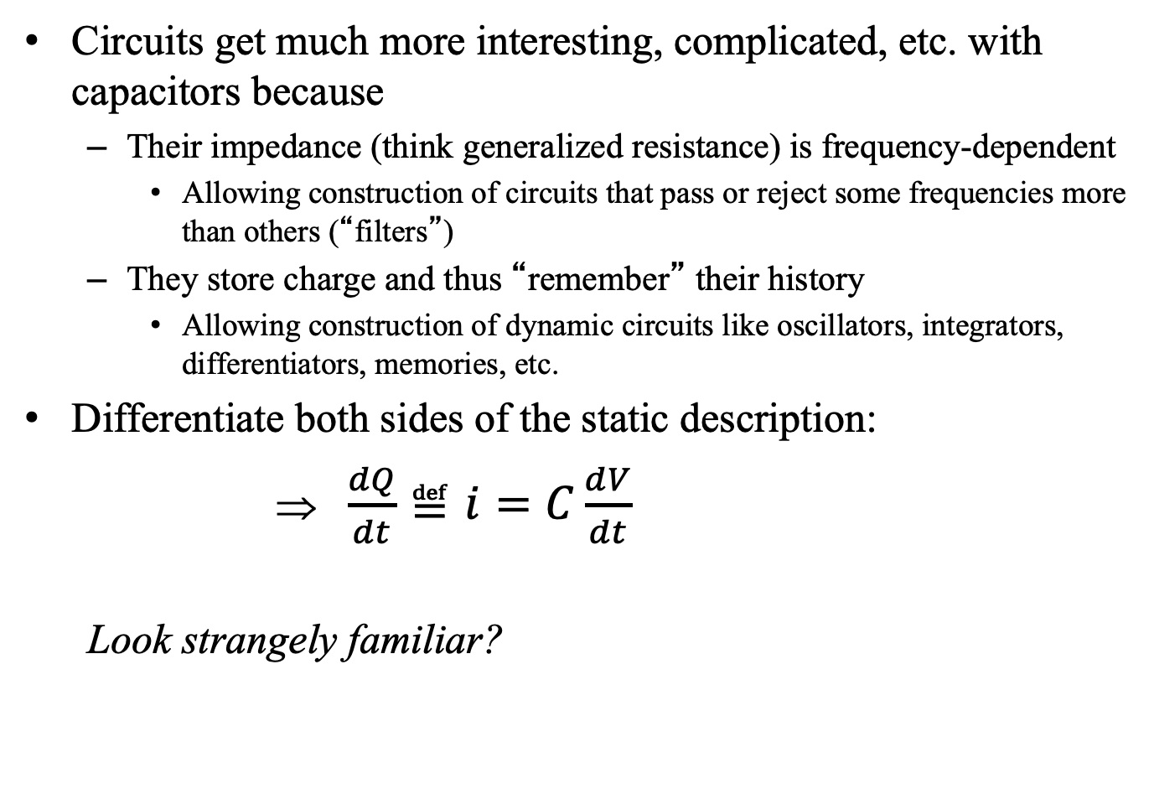
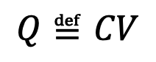
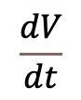
Capacitors
Circuits get much more interesting, complicated, etc. with capacitors because
Their impedance (think generalized resistance) is frequency-dependent
Allowing construction of circuits that pass or reject some frequencies more than others (“filters”)
They store charge and thus “remember” their history
Allowing construction of dynamic circuits like oscillators, integrators, differentiators, memories, etc.
Differentiate both sides of the static description:
⇒ $\frac{dQ}{dt}≝i=C\frac{dV}{dt}$
Look strangely familiar?
$$Q≝CV$$
i
Slope = C
$$\frac{dV}{dt}$$

Slide 7
Practical capacitor tips
Reading actual capacitor values can be ugly
Mfg’s make it almost unintelligible
Big ones are polarized as are some small ones
Units are microfarads (MF, μf) or picofarads (pf, typical for small ones)
4R7u = 475K = 4.7μf 10%
Don’t hesitate to verify by measuring with a capacitor meter
Subtract the “zero” reading with the probes almost touching
Many different types of capacitors trade off various imperfections and idealizations
Inductor labeling is worse …
47 * 10⁵ pf 10% tolerance

Slide 8
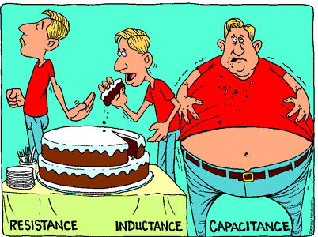
An engineer learns to see R’s and C’s in multiple functional ways – a nail isn’t just a piece of metal to hold together 2 pieces of wood. It also unclogs your glue gun, extends a magnet to reach into tight places to pick up a dropped piece of ferrous metal, … (I’m sure you can think of >5 other uses for a nail …)

Slide 9
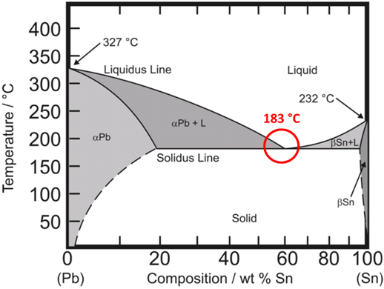
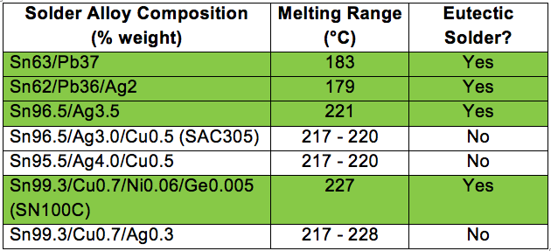
Eutectic solder
63% Sn/37% Pb has the fastest transition between liquid and solid, with no “slush phase” that can make a weaker joint
60-40 is also common in electronics (don’t know why)
Adding 2% Ag lowers MP 4°C, and raises price $$
Small Ag wire quickly dissolves in regular solder
Healthier/safer lead-free solders have much higher MPs

Slide 10
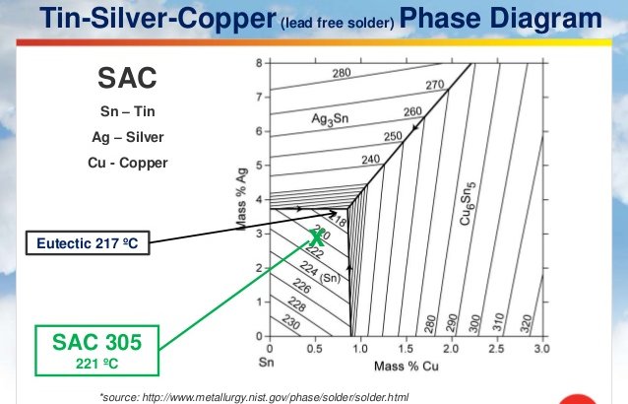
Material science and metallurgy is a fascinating area of engineering (and physics and chemistry, history, …) Isothermals in °C

Slide 11
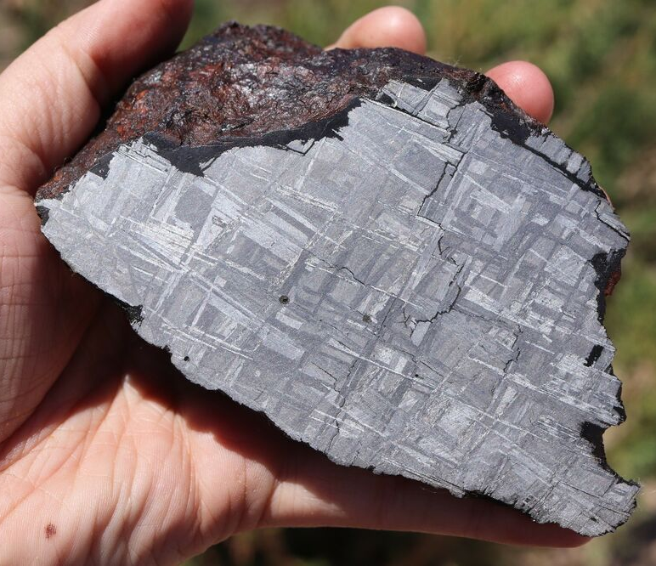

Damascus Steel, Gibeon meteorites, …
Digression ….
Acid etching reveals grain boundaries in meteorites and folded “Damascus steel”
Large grains are from slowwwww cooling (Fe-Ni, not possible to fake)
https://en.wikipedia.org/wiki/Widmanstätten_pattern

Slide 12
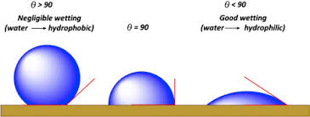
Practical Soldering Tips
Make sure iron has a dab of clean oxide free molten solder on it …
If solder won’t stick to iron then fix the iron before proceeding ...
Molten solder conducts heat much better
Make sure iron is only as hot as necessary and clean of oxide ...
Know what kind of solder you are using
Sn/Pb eutectic solder has much lower MP than lead-free solder → cooler iron
Pre-coat both surfaces with clean oxide-free (shiny) solder
Check that wetting angles are small
Use a heat sink (e.g., aligator clip) for temperature sensitive components

Slide 13
Soldering safely
https://prototyping.ucsd.edu/_files/soldering_guidelines.pdf
LBNL has a more extensive guide and course:
https://eta-safety.lbl.gov/sites/default/files/Soldering%20Guidelines.pdf
https://training.lbl.gov/ehs/training/webcourses/EHS0243/story.html

Slide 14
Building a Variable DC Power Supply
Building a variable DC voltage source
A variable DC power supply is very handy, e.g., to generate I-V curves, power circuits, etc., so let’s build your own
Engineering is always about trade-offs:
Faster, Better, Cheaper – at best you generally get <= 2
Anecdotes from JPL and Amgen
What are we willing to trade?
Lower output power – sort of like cars, most applications don’t need 400 horsepower or 4WD …
Max voltage ~ 12V
Variable constant voltage for currents betweeen 0 - ~100mA
The magic of integrated circuits (and globalization) allows us to build a remarkably good DC PS for almost nothing ...
Google “LM317 datasheet“, and look for a pdf file (there‘s a plethora of companies trying to make money selling data sheets or ads around them – try to avoid that spam by looking for pdfs
https://cdn.sparkfun.com/datasheets/Components/EL/EL_Escudo_Dos/LM317.pdf

Slide 15
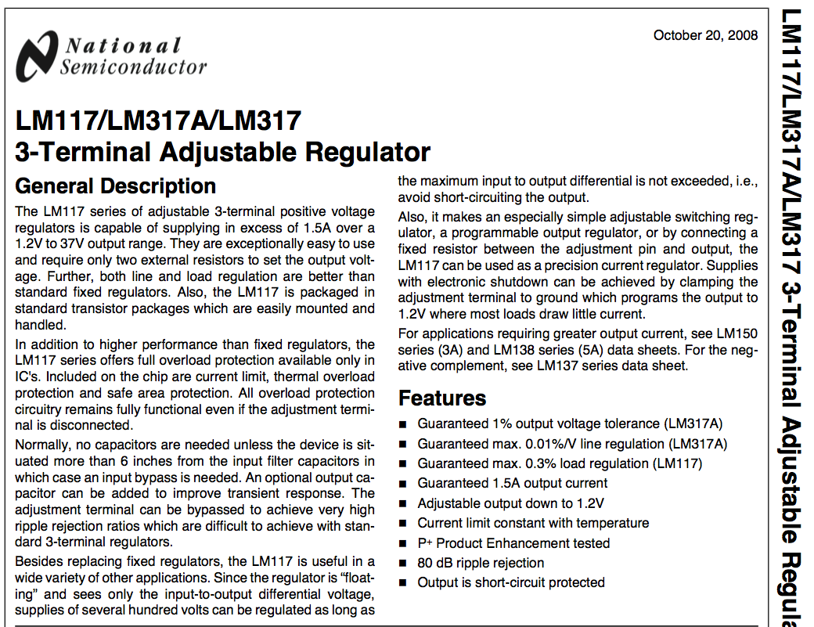
<$0.20
Google: “LM317 datasheet pdf”

Slide 16
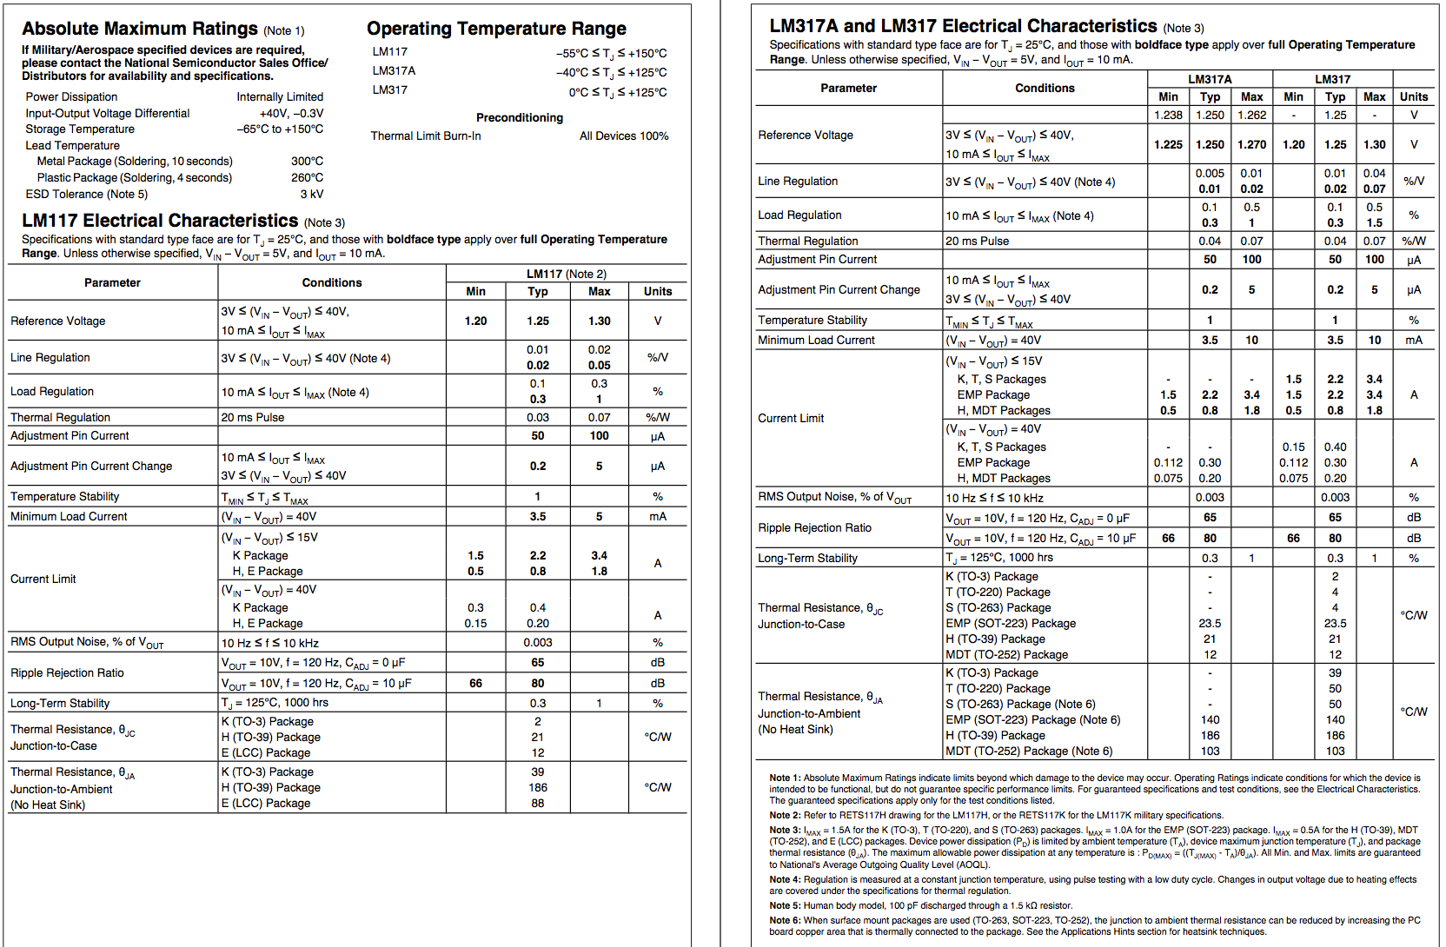

Slide 17
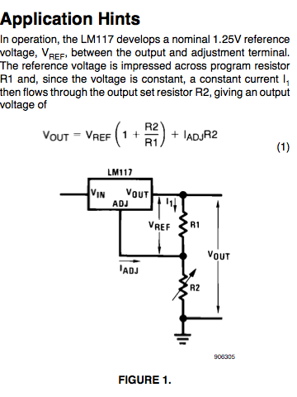
How to parse all this?
Absolute Maximum Ratings on pg. 1 are important
Scan … I look at the units in the tables, the axes on the graphs
Jump to Applications:
Data sheets are like an encyclopedia … you don’t read them linearly, but look for answers within
Always build simple circuits – don’t assume you understand these devices …
Treat them as mystery boxes & characterize them empirically

Slide 18
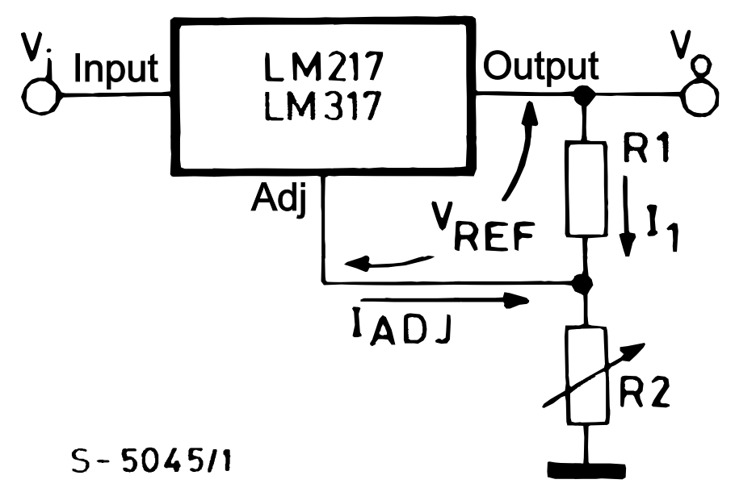
Our First LM317 design
Based on the App Note
V_{out} = V_{REF} * (1+R₂/R₁) + i_{Adj} * R₂
From the specs: i_{Adj} < 50μA & V_{REF} = 1.25V (2 eqns)
Pick i₁ ~ 100* i_{Adj} ~ 5mA to ignore last term
R₁ = 1.25V/5mA = 250Ω
12V = 1.25(1+R₂/R₁) → R₂/R₁ ~ 9.
9*250Ω = 2250Ω pot, but we don’t have one …
We have a 10k pot, so working backwards, R1 = R2/9= 1.1kΩ
So we’ve designed our power supply!
The reductionist approach to engineering – divide and conquer
To build it, do we need a 1.1k resistor?? What should we use?
What else is missing?
V_{out} = V_{REF} (1 + R2/R1) + I_{ADJ} R2

Slide 19
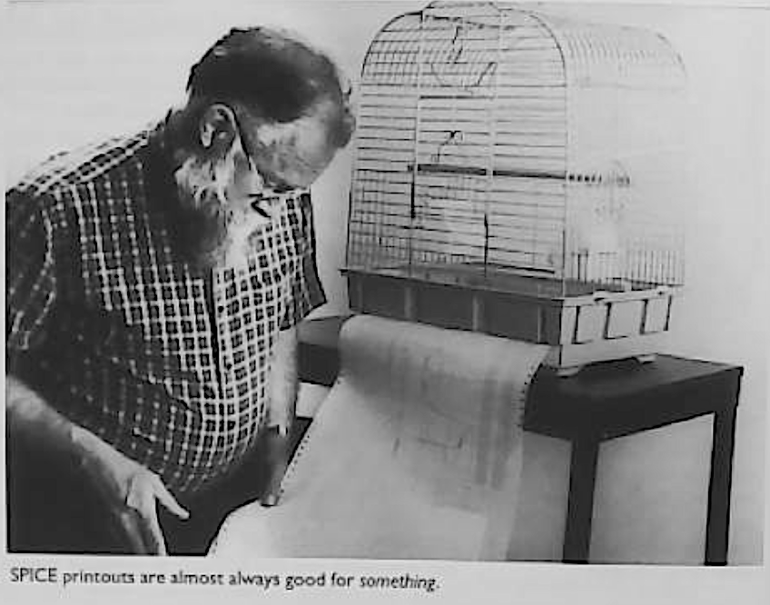
Simulation
Simulation is another powerful method that suggests circuit behavior
Eagle and other CAD tools offer simulation engines
SPICE is the most common discrete component circuit simulator
Other simulators are used for ICs (e.g., MOSIS)
Since ~1990, computers became too complex for humans to design so we program simulators to design them
Instead of using a proprietary, special-purpose simulator, I’ll show you how to simulate circuits (and many other things) from first principles in Matlab
LM317simulation.mlx
From Robert Pease (1991) “Troubleshooting Analog Circuits”

Slide 20
Design -> Prototype -> Construction
After drawing a schematic …
Validate design by building a prototype
The engineering trade-offs in a prototype are ease and flexibility over robustness – because the prototype only has to work long enough to prove the concept (and to explore revisions that might improve performance)
Implicit in each step is testing and debugging
What are the expected characteristics?
How will we know if its working or not?
If not, how will we troubleshoot the problem(s)?

Slide 21
Construction: prototype → solder
Move the power supply circuit to the perforated brown board and solder it together, so it is robust and not dependent on the flakey breadboard connections
Normally, you’d keep the prototype intact until you confirm the soldered device is working
Sometimes design flaws or other issues arise during construction, and the prototype remains useful – the cost of keeping it maybe small compared to the probability * cost of rebuilding it
As students, you don’t have a second set of parts, so you have no choice but to cannibalize the prototype – so take careful notes – e.g., make sure to use the same pins on the pots
Don’t let the mirror image of the back of the board vs. the front of the board confuse you … move slowly and methodologically …

Slide 22
Soldering the DC Power supply
The schematic diagram should maximize the functional clarity of the circuit
Make a separate parts layout diagram to help you figure out the best physical arrangement to implement your circuit
What does “best” mean??
Compact
Few overlapping connections (that require insulated wires)
Doesn’t obfuscate function, e.g., signals generally flows left to right …
Serviceable for the future …
…
Also consider the size and shape
And heat – e.g., keep electrolytic capacitors cool
At high frequencies, consider parasitic capacitance (what’s that?) and shielding
And ergonomics of interfaces (knobs, i/o ports, …)
Engineering is all about compromises and trade-offs

Slide 23
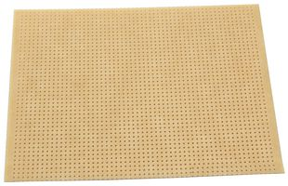
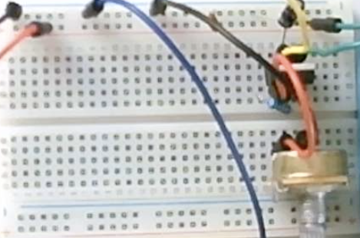
Real Estate Planning
Keep the PS in the bottom left corner of your circuit board, the solderless breadboard will go on the right; our function generator will fit in the top left corner behind the PS … so your PS shouldn’t extend above the bottom of the breadboard
Switches and knobs face towards bottom …
Function generator
DC Power Supply

Slide 24
Real Estate Planning
If you’re using a long version of the solderless breadboard …
Switches and knobs on this side (bottom)
Function generator
DC Power Supply

Slide 25
Schematic Diagram
Let’s add a power (on/off) switch for ease and safety
What about C1 and C2?
Anything else?

Slide 26
Layout Diagram
Draw the Layout diagram from the schematic
Draw to (approximate) scale -- on graph paper or with a CAD tool
Any errors in the schematic will be copied
Use this opportunity to double-check the schematic
Try to keep connections short enough that you can use the component leads to make connections
Try to avoid wires crossing – which require insulation
Draw just enough connections for clarity and verify
As I start assembling, I often change the layout to make it better

Slide 27
Strain Relief
If a part wiggles or moves, the solid wire leads will fatigue and break, so you have to ensure the larger parts can’t move
Solder 2 wires onto the switch and feed through the board
Watch the video for placement. Ergonomics vs. stability
Tighten a loop of solid wire around the neck of the switch for mechanical stability (movement will fatigue and break wires)
Solder the loop so it doesn’t loosen
Use the long-nose pliers to gently bend the LM317 leads so it lays flat (compromise better cooling vertical vs. stability flat)
Fold its leads so it doesn’t fall off
Avoid sharp bends that can also fatigue wires
Placing electrolytic capacitors C1 & C2 underneath/behind R2 give R2 mechanical stability
Note the layout diagram tells where each labeled part is physically; the schematic diagram tells how the parts interconnect. Trying to do both in one diagram usually results in utter confusion

Slide 28
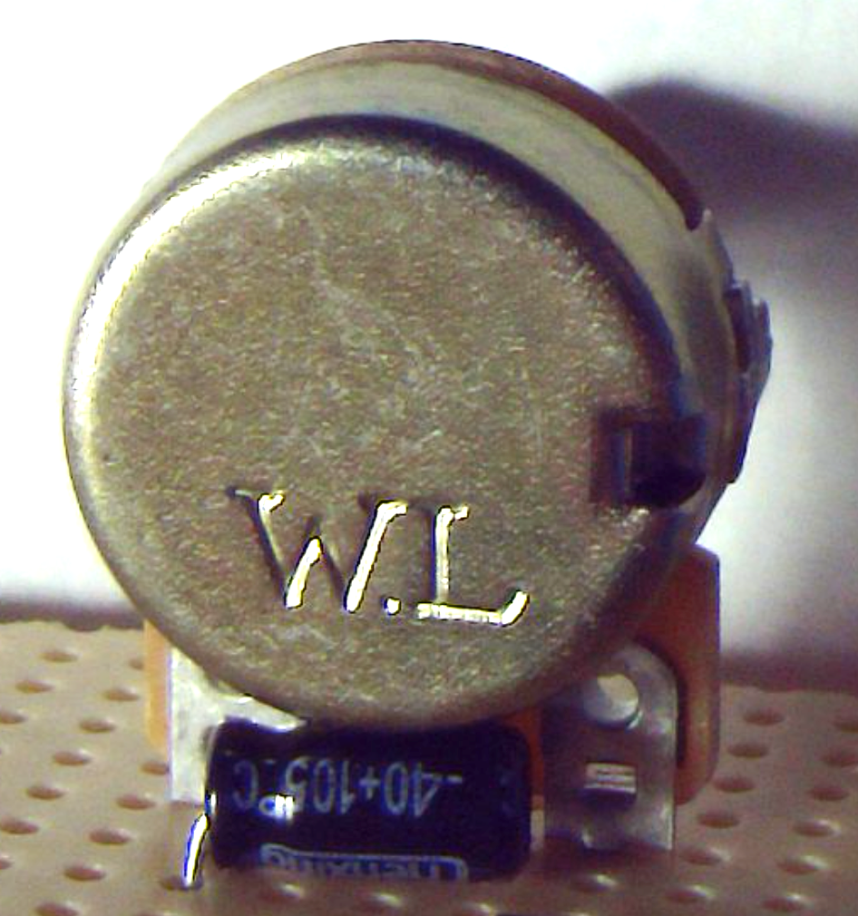
Found a strain relief for the Pot …
A 100uf capacitor on its side is about the right height to lean the body of the potentiometer on so it can’t flex backwards too far
Might as well use it for C1 -- an unconventional use for a capacitor!!
In class, we used 5 minute epoxy to strain relieve the pots and switch
Solid copper (like the leads of the pot or wires to the switch) will break if they repeatedly flex → make sure they don’t move

Slide 29
Testing …
“There are old pilots and there are bold pilots. But there are no old, bold pilots.” – Air Force saying
Just plug it in (“smoke test”) and be bold?
A minimum is careful visual inspection
Better is use your ohmmeter to verify each connection
Check polarity of electrolytics (e.g., ohmmeter negative lead to ground)
Before plugging in, plan your tests
How will you know it is working??
Touch the IC to verify it is cool
Connect the voltmeter (don’t forget to SWITCH FROM OHMS TO VOLTS DC) to the output
Turn the pot R2 and record the results … you expect _________

Slide 30
Debugging …
Of course it doesn’t work … (Murphy’s law) … what to do?
I suggest (after unplugging)
Write down what you tested and what happened (the act of writing helps you think, along with not having to repeat the same experiments)
Reductionism (divide and conquer): Look at the schematic and interpret the behavior … can you conclude any part of the circuit is working and can be ignored? If not, is there another measurement you can make that would give you definitive answers to that?
E.g., check Vin (pin 3) … is the switch working?
Is the 317 backwards (pin 1 & 3 flipped)?
V_{out} = V_{Ref} * (1+R₂/R₁) + i_{Adj} * R₂
so if R₂ = infinity …
if R₁ ~ 10kΩ? …

Slide 31
Embellishments
Let’s add a voltage display … this serves 2 purposes
Frees up your voltmeter to measure other voltages
Is a visual indicator when the power is on (otherwise you’d have to design and install the equivalent of an LED nightlight on the board
How to connect your 3-digit LED voltmeter?
There are 3 wires (and no documentation)
Convention would suggest: Red = ~5-12V to power the display; Black = Ground; White = voltage to measure
Safer would be to put 100 ohm resistors in series to limit current in case you’re wrong. If 100 ohm is too big, it may not light up or be dim, but i_{max} < 12V/100ohm
Layout: where/how to put it?
Use wire to tie it to the board, maybe a piece of folded paper or tape to hold it at an ergonomic angle
Keep it tight but ergonomic … (trade-offs)

Slide 32
Feet
To avoid scratching the desk and risking a short if placed on a conductor, its nice to elevate the board …
What can we use (that we have) as feet?
How about 4 LEDs (upside down)?
And how about turning them on …
Series or parallel?
Series guarantees the currents are all the same
Their forward voltages will add …
KVL: iR_{s} + 4V_{f} -12V= 0. If V_{f}~2V and i ~ 2mA, then one unknown: R_{s} = 4V/2mA = 2kΩ
To debug, if any LED is backwards, it will block current and the full 12V will be across it

Slide 33
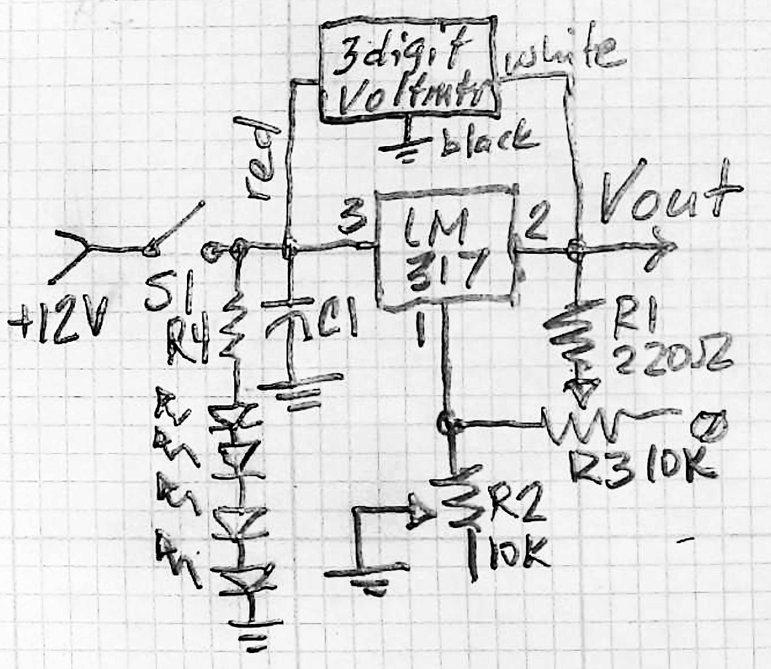
Documentation
Its all working …
Take pictures, note min and max voltages, any notable behaviors, lessons learned …
Test it under load (if not part of your original testing) … Note the voltage change when connected to a 100Ω resistor (don’t burn yourself: P = V²/R = 11^2/100 > 1W)
Note: as the schematic grows in complexity, we easily lose sight of where and how it started … schematics don’t capture history
This schematic is out of sync with the actual circuit – it doesn’t show R3 nor the feet circuit, the C’s have different values … keeping documentation in sync with changing designs can be a big challenge

Slide 34
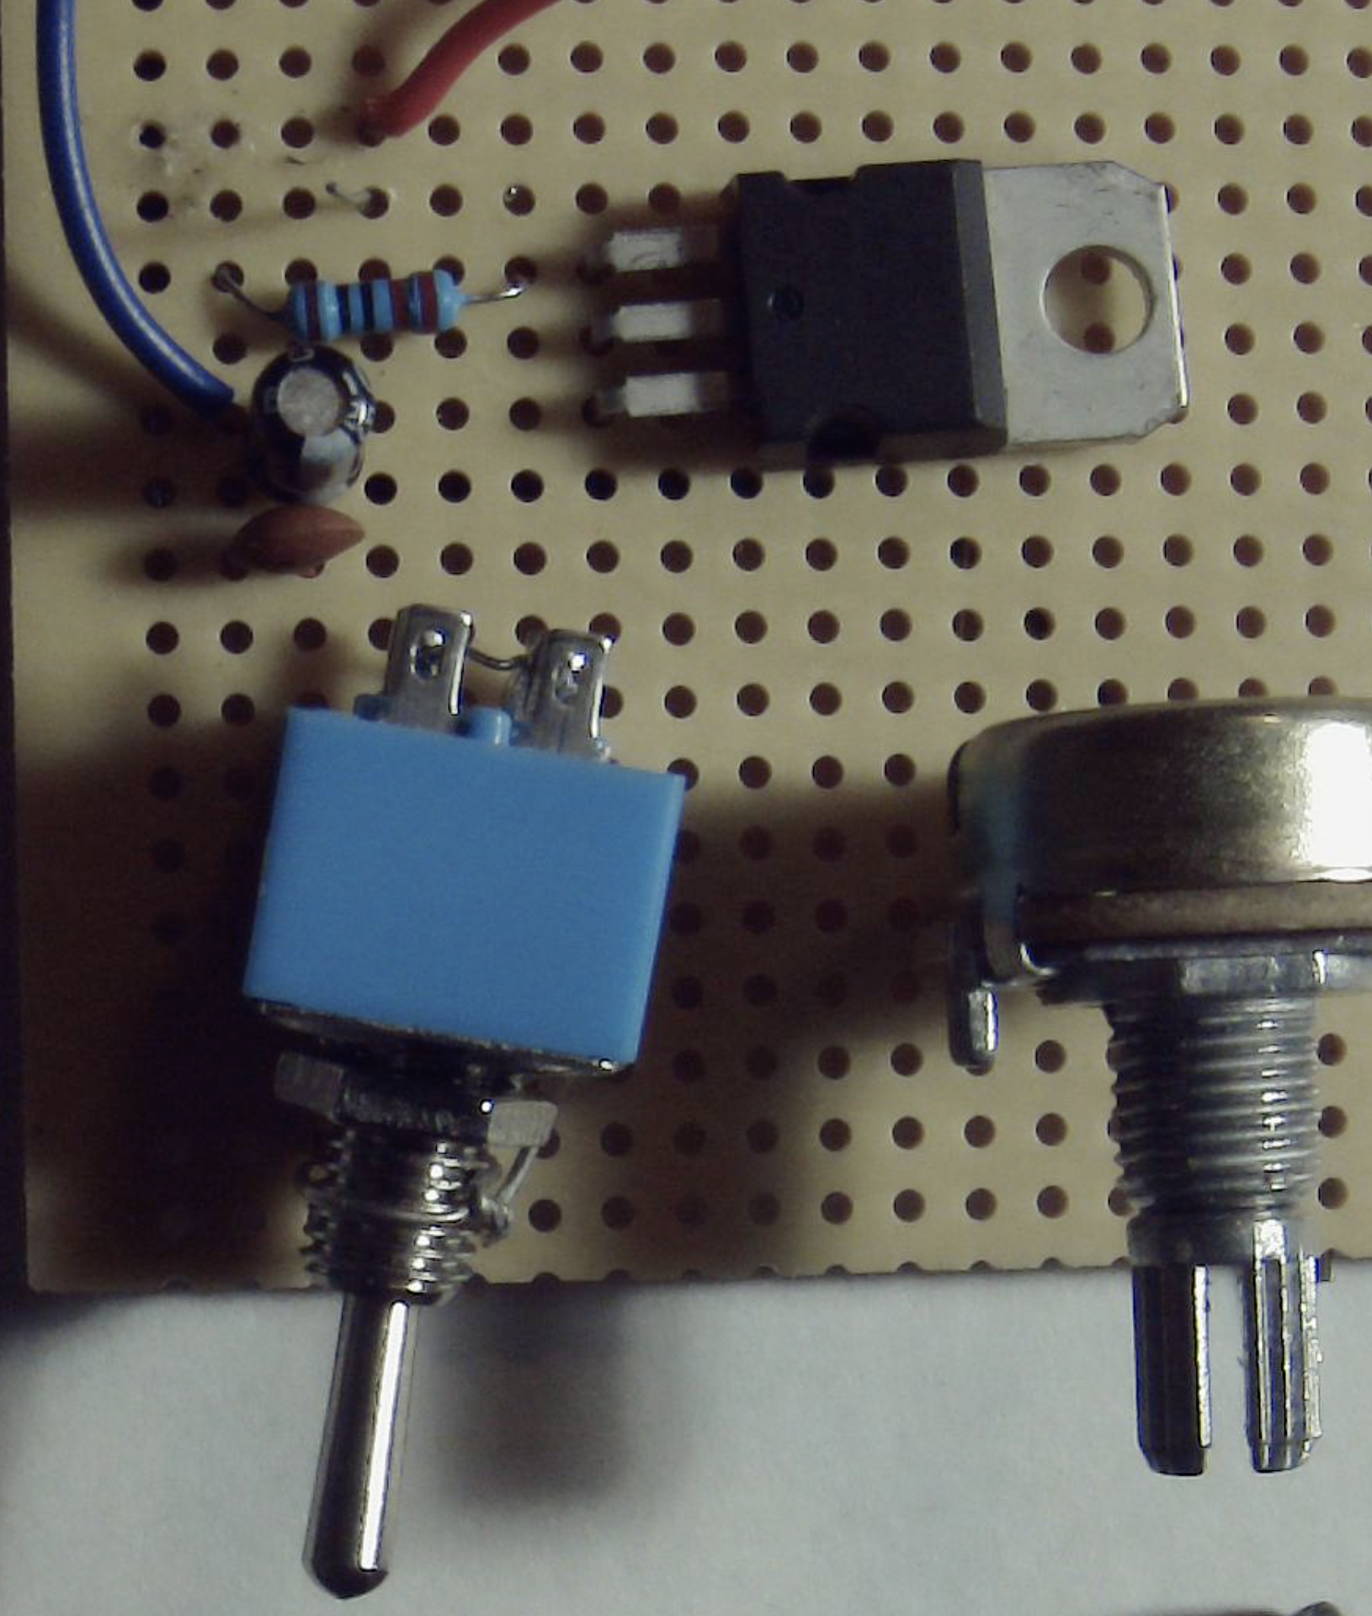
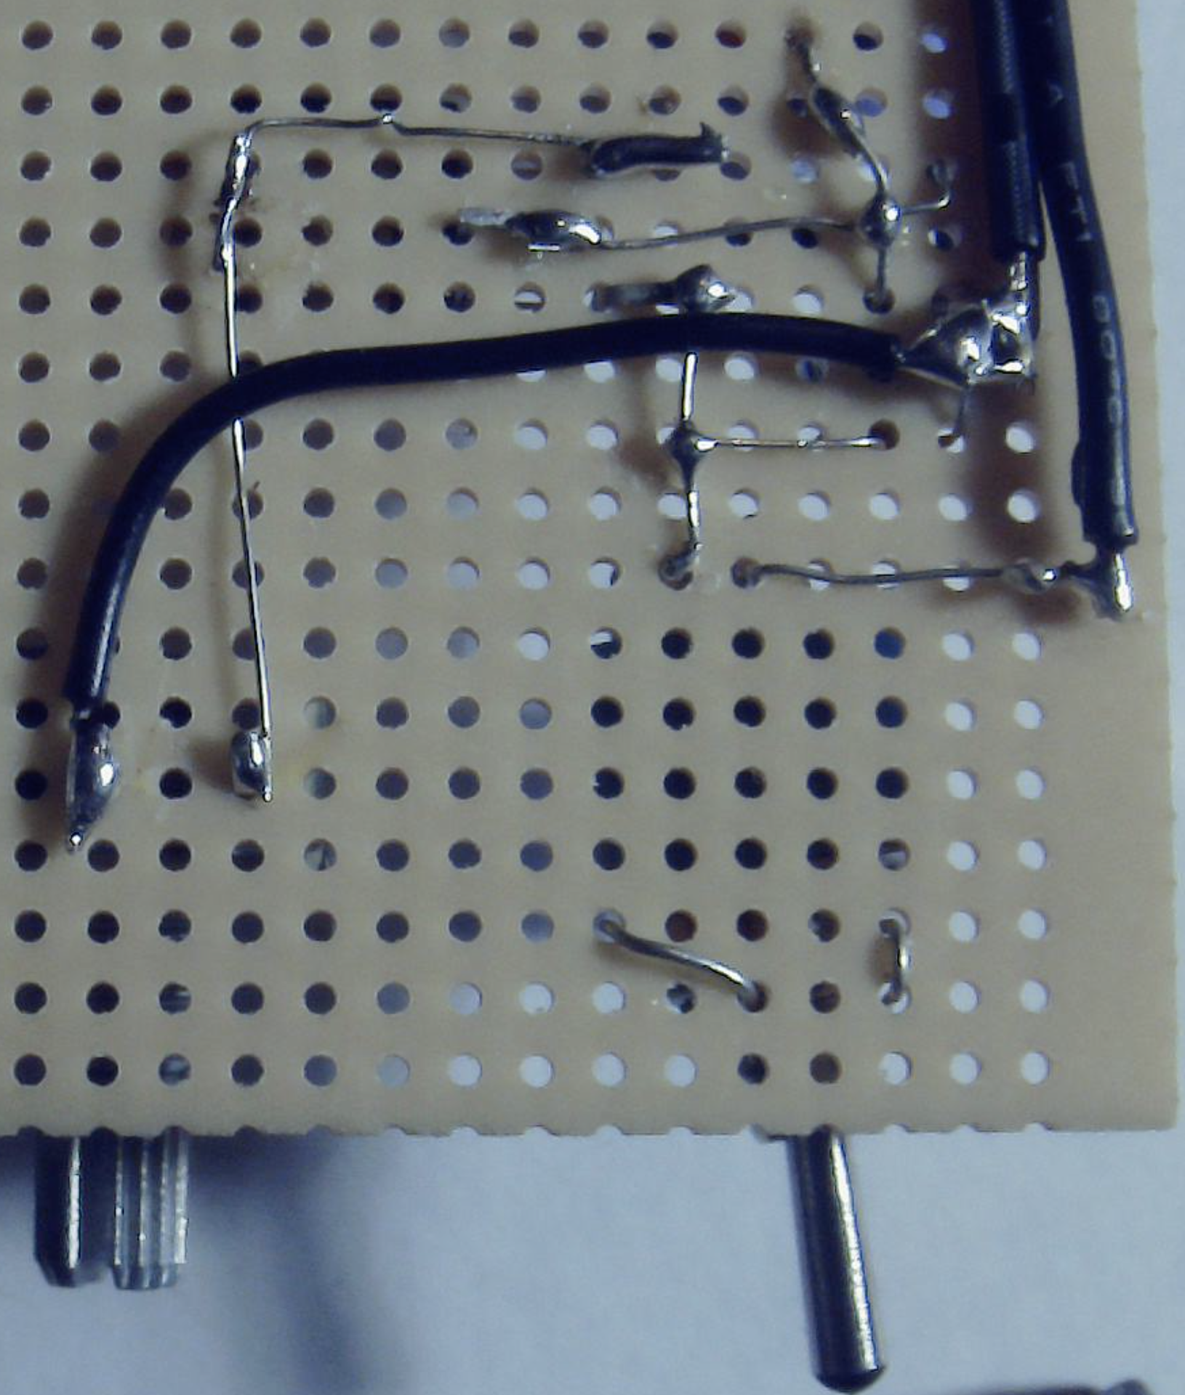
X-Ray
Vision

Slide 35
DC Power Supply Lab Report
Who’s your audience? Imagine you’re in grad school and you need a DC power supply and you remember that shoebox in your closet … from CI’s 310 class … Your lab report should be written for that future you – what does it do, how do you use it, and if it happened to be a little damaged after all those years, how would you troubleshoot it and repair it?
Imagine next semester you take EMEC 316 here, and you need a PS … (that’s very likely!!)
Including a reference to the datasheet (URL) would be appropriate

Slide 36
What do you need to learn?
Rasnow’s thesis: Modern electronics skills can help you market yourself and thrive (survive) in the workforce
How can you learn “modern” electronics – what will it be like in 10-50 years?
Do we have any frickin’ idea about components and functions?
Thevenin’s theorem survived since 1883
Will it use resistors and capacitors in some forms? ICs?
Will we think of functional abstractions like amplification and filters? Power budgets? Feedback regulation?
What about even bigger abstractions – like patience, aesthetics, Quality?
There are many things we can study and practice now that will most likely be relevant in the uncertain future

